Slide 1

Orbit Protocol
Institutional-Grade Yield on Stellar Soroban
Earn Real Yield · Yield Tranching · P2P Collateral Lending
Notes:
1

Slide 2



Three Structural Failures in DeFi Today
Fake Yields
Capital Inefficiency
Stellar Has No Yield Layer
85% of DeFi APY = printed tokens, not real lending returns
Users choose yield or liquidity — never both simultaneously
Zero native tranching, fixed-income, or structured products
Notes:
2

Slide 3
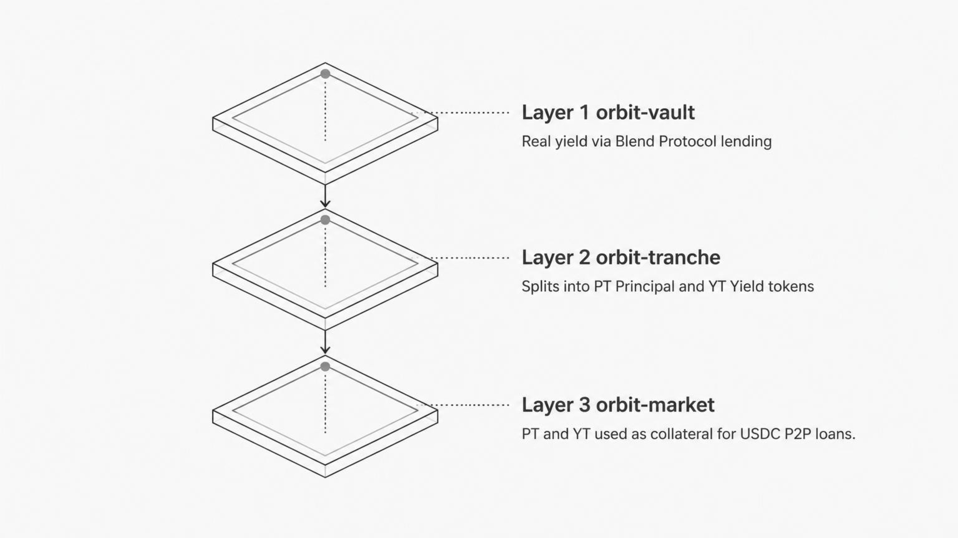
THE PROTOCOL
Three Layers. One Integrated Stack.
Capital enters through orbit-vault, is structured by orbit-tranche, and deployed as collateral via orbit-market — all within a single composable protocol.
Notes:
3

Slide 4
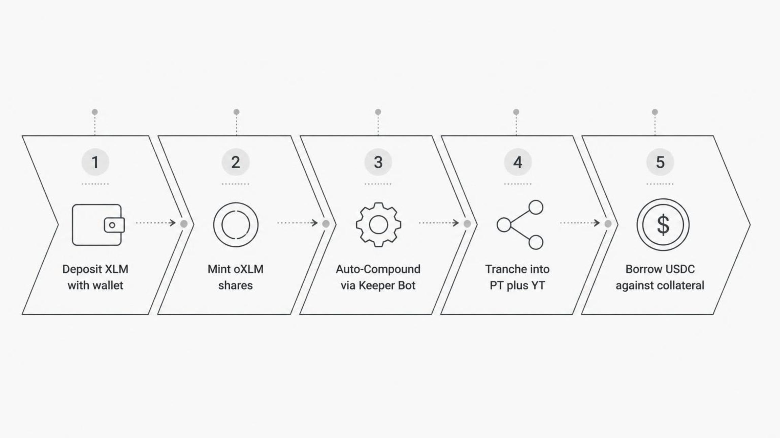
USER JOURNEY
From Deposit to Collateralized Loan in 5 Steps
Each step executes on-chain via Soroban smart contracts. No manual compounding. No fragmented UX. Full capital efficiency from first deposit to active loan.
Notes:
4

Slide 5
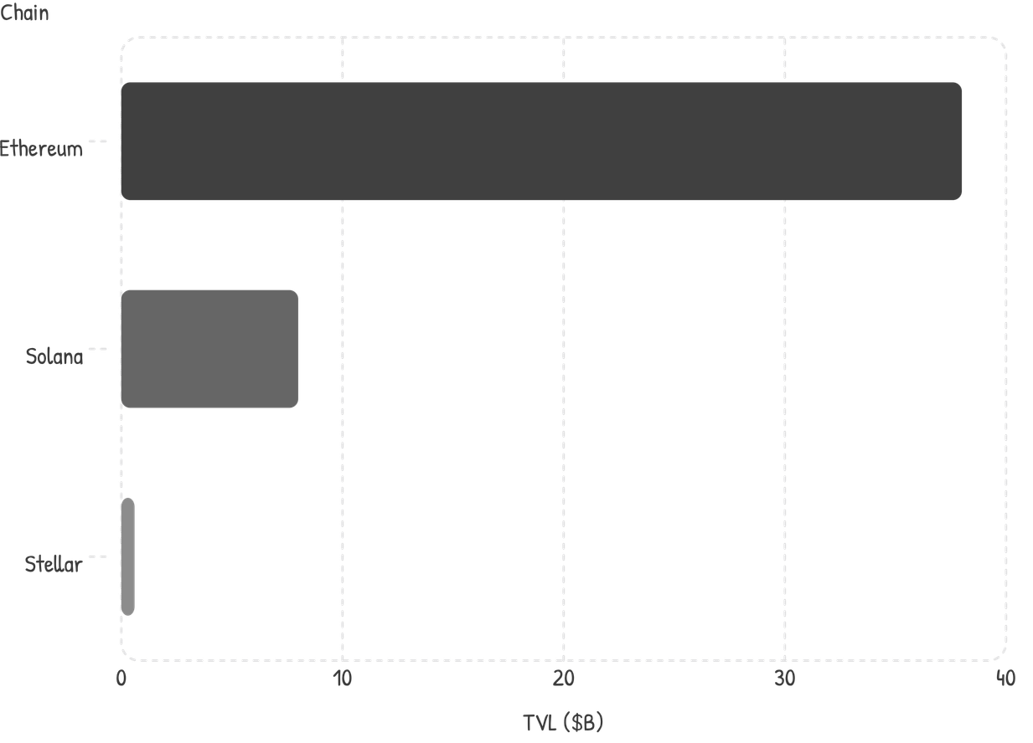
MARKET OPPORTUNITY
A $48B Market With Zero Native Competition on Stellar
$48B+
$600M+
0
Total DeFi TVL
Stellar Liquidity
Native Tranching Protocols
Addressable yield market (DefiLlama, 2024)
Active ecosystem capital (Stellar Development Foundation)
On Stellar today — Orbit is the first
Stellar's TVL is early-stage relative to Ethereum and Solana — representing a first-mover window for native yield infrastructure before the ecosystem matures.
Notes:
5

Slide 6
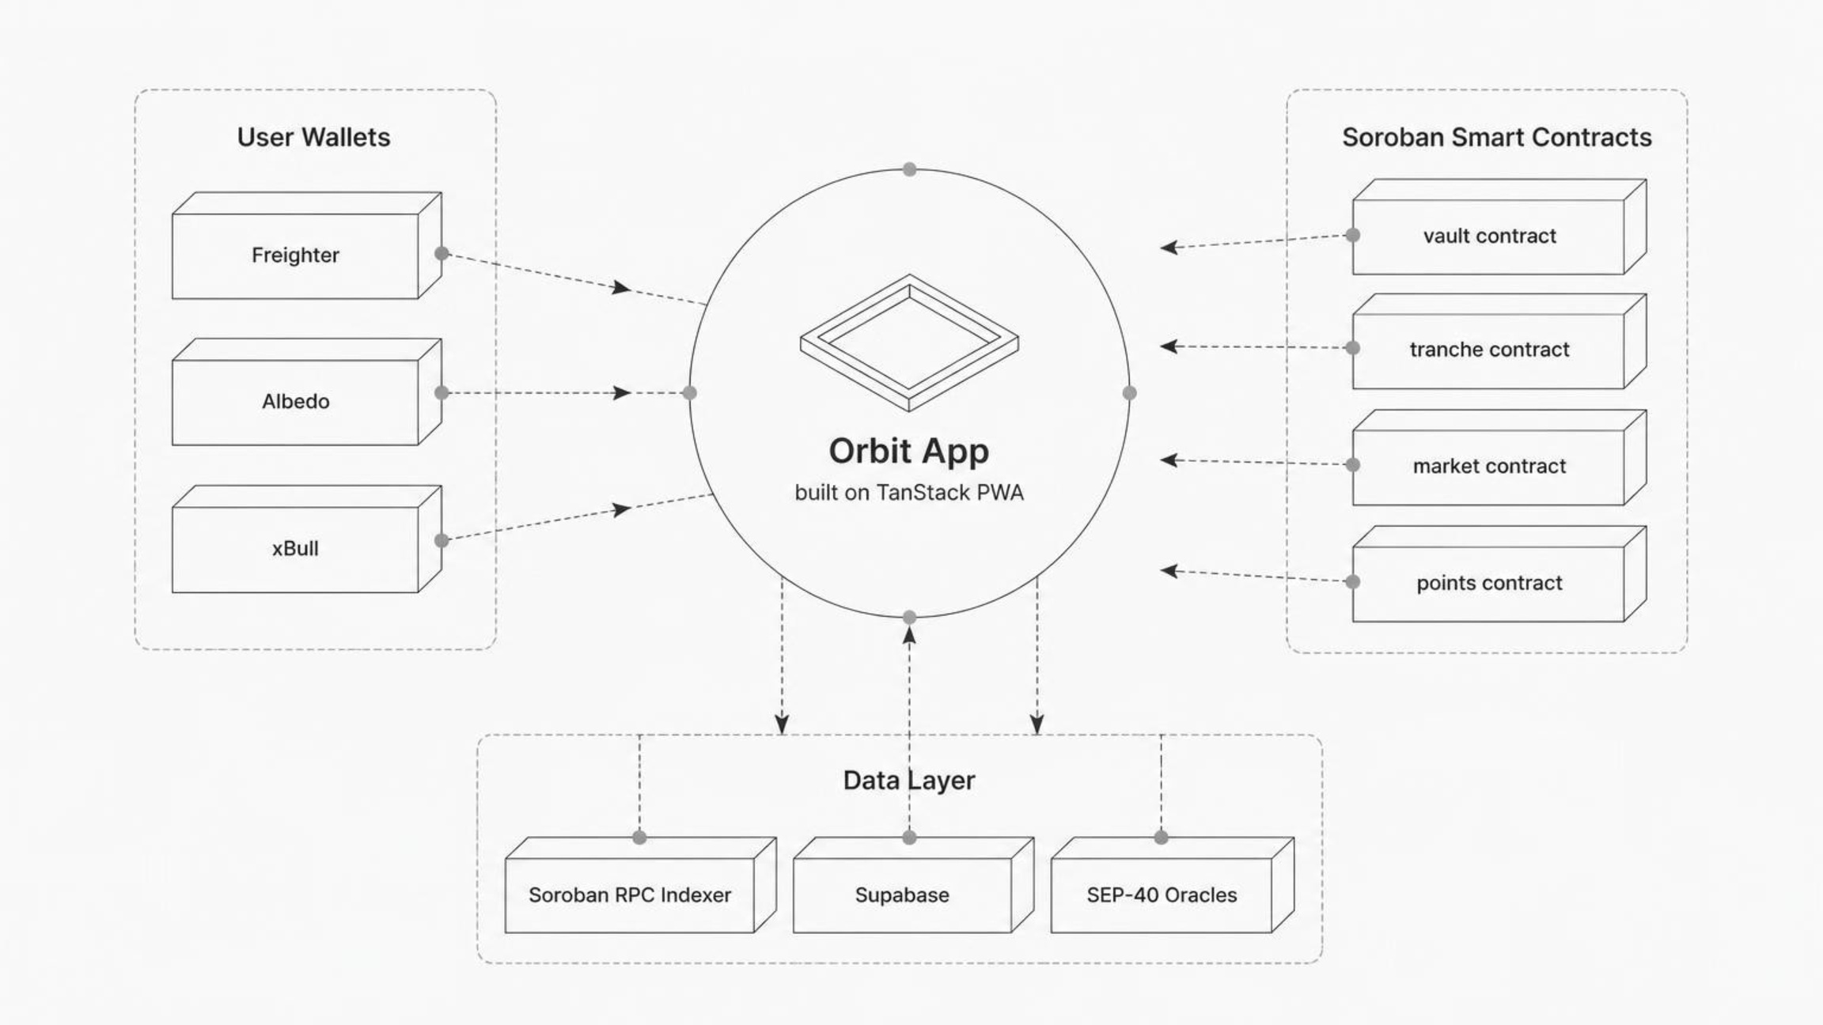
TECHNICAL ARCHITECTURE
Full-Stack Soroban Deployment
Contracts deployed and verified on Stellar Expert. SEP-40 oracles provide price feeds. Supabase handles off-chain indexing. PWA ensures mobile-native access via Freighter, Albedo, and xBull wallets.
Notes:
6

Slide 7
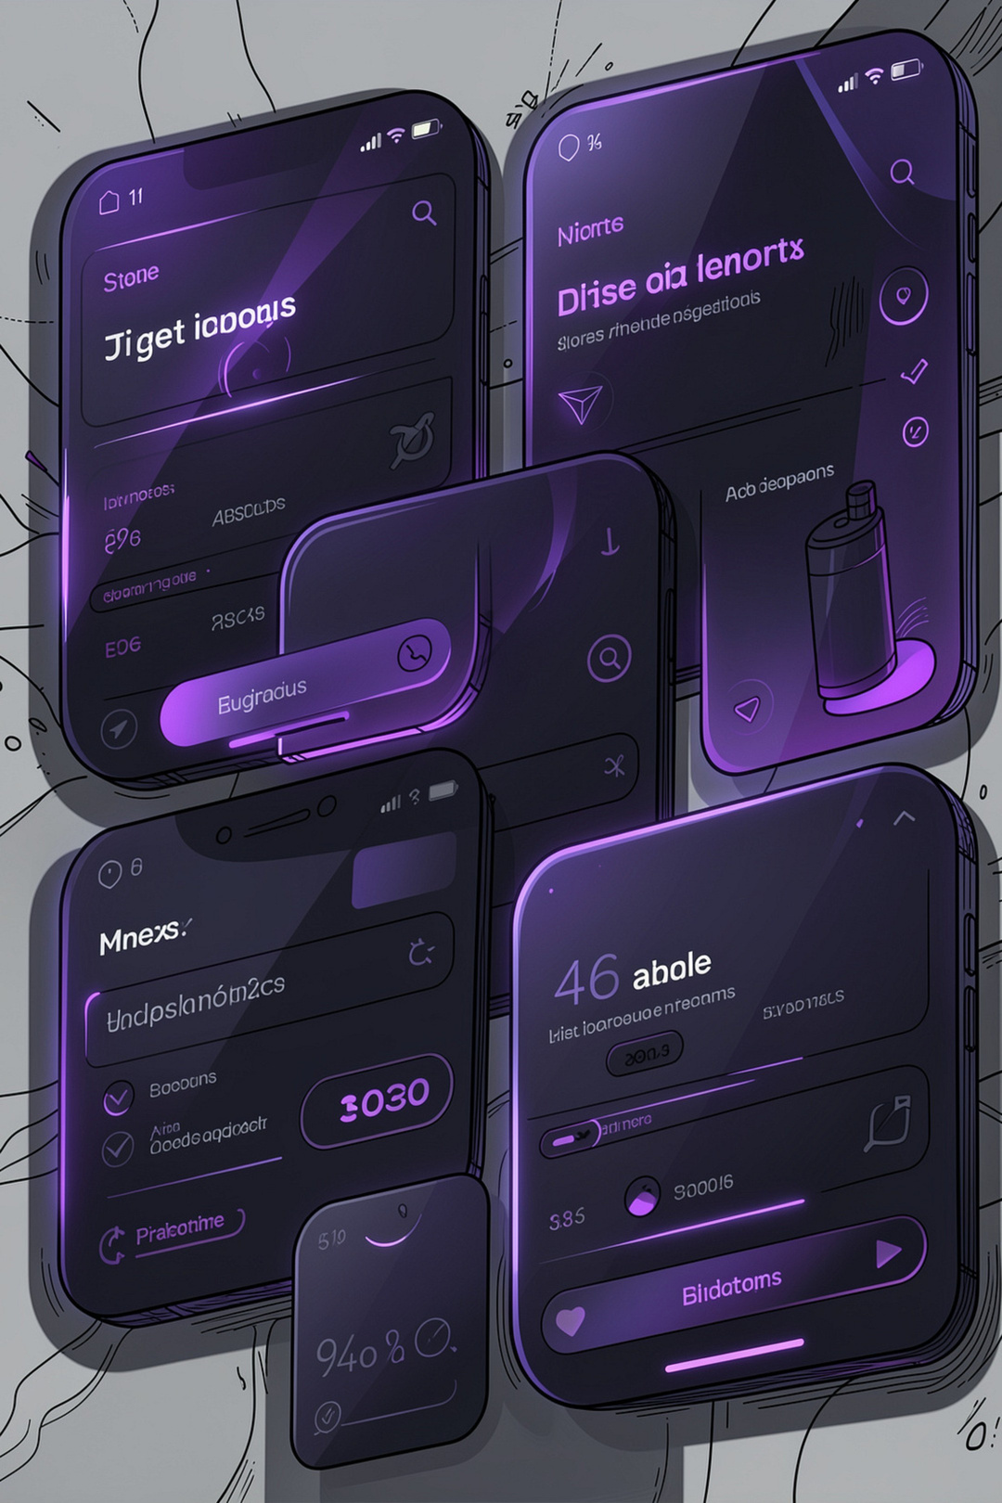

SHIPPED IN 48 HOURS
Built From Your Feedback
Production-Grade Zap Router
Atomic swap + deposit in a single transaction via allowance pattern
✓ SHIPPED
Auto-Compounding Vaults & Keeper Bot
Live orbit-yield-strategy contract + automated harvest keeper
✓ SHIPPED
Notes:
7

Slide 8

LIVE METRICS
Testnet Is Live. Proof Is On-Chain.
9
[X]
Contracts Deployed
Verified Transactions
All verified on Stellar Expert
Live on Stellar Testnet
[X]
[X]
Unique Wallets
Feedback Responses
Connected during testnet phase
Collected via user form
See It Live
Live demo: stellarorbit.vercel.app
Video walkthrough available on YouTube
Notes:
8

Slide 9

GO-TO-MARKET
Three Phases to Institutional Scale
Phase 1 — Now
Phase 3
Testnet
Protocol DAO
Community building & feedback loops
Hackathon exposure
Contract audits initiated
Governance token launch
Cross-chain bridges
Institutional market-making partnerships
1
2
3
Phase 2
Mainnet Launch
Live Blend Protocol integration
SEP-24 fiat on-ramp
Institutional wallet support
Notes:
9

Slide 10
ROADMAP
What's Live, What's Next
Live on Testnet
In Progress
Soroban Yield Vaults
Yield Tranching — PT / YT
P2P Collateral Market
Auto-Compounding Keeper Bot
Production Zap Router
Mainnet deployment
Upcoming
Governance & DAO — Q1 2027
Cross-chain yield aggregation — Q2 2027
Institutional fixed-income desk — Q3 2027
Notes:
10

